Slide 1
Demand Side Management for a Campus Infrastructure
TEAM MEMBERS
ASWIN NATESH. V (212712105023)
BADRI NARAYANAN. N (212712105025)
GANDHI RAJAN. R (212712105031)
MOHAMED SAQIB. A (212712105061)
BATCH : A6
TYPE : IN-HOUSE
GUIDE : DR. SG BHARATHI DASAN
Sri Venkateswara College of Engineering
Pennalur, Sriperumbudur Taluk Anna University : Chennai 600 025

Slide 2
Project Objectives
To reduce the peak electricity demand by:
Improving the load curve
Proper Utilization of Diesel Generators
Effective utilization of existing Photovoltaic Panels

Slide 3
Abstract
Due to large industrial and overall development of the country, demand for electricity has seen to be exponentially increased during last decade.
Demand side management (DSM) is one of the important functions in a grid that allows consumers to make informed decisions regarding their energy consumption, and helps the energy providers reduce the peak load demand and reshape the load profile.
A load shifting demand side management technique is utilized here to transfer low priority consumer loads from high demand to off peak periods, which can intern reduce critical peak demand.
Simulations are carried out for a university infrastructure, utilizing the existing photo-voltaic array DG generators.
These existing assets are treated as a local grid and evaluated for four different operational scenarios. The results show significant cost savings are achievable with the proposed optimization strategy

Slide 4
Overview
Simulations have been carried out for a campus infrastructure utilizing existing assets such as DG Sets & PV Panels.
SCENARIO 1 – Primary Supply alone
SCENARIO 2 – DSM during peak demand hours
SCENARIO 3 – Primary Supply with PV Integration
SCENARIO 4 – DSM with PV during Peak demand hour
SCENARIO 5 – Diesel Generator with PV Integration

Slide 5
Literature Survey
Author | Paper Title | Year | Summary
Nandkishor Kinhekar | Utility Oriented Demand Side Management Using Smart AC and Micro DC Grid Cooperative | 2015 | Demonstrated a load shifting demand side management (DSM) technique used to shift AC industrial loads in response to time of day (TOD) tariff
Logenthiran.T | Demand Side Management in Smart Grid Using Heuristic Optimization | 2012 | Proposed a day-ahead load shifting technique, mathematically formulated as a minimization problem
Govardhan.M | Impact of demand side management on unit commitment problem | 2014 | Uses two essential approaches of energy balance (i.e. energy shifting) and load reduction during peak hours.

Slide 6
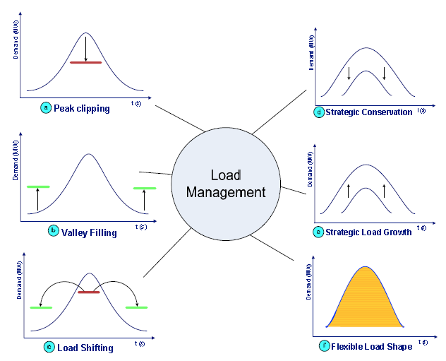
DSM Strategies
Load Shifting
Most widely applied load management technique in current distribution networks.
Shifting of loads from peak periods to off peak periods
Alternative to traditional load shedding

Slide 7
DSM Modelling
Load Shifting Process
Power (in kW)
Time period
Power (in kW)
Start Time
Operation Time
1 2 3 4 5 6 7 8
Time (in hrs)
Time (in hrs)

Slide 8
Device Parameters
Device Name
Device Number
Device Rating
Initial Scheduling Time
Operation Time
Operation period
Maximum permissible delay
Original Delay
Each and every device data stored in separate memory connected to microprocessor.
These data can be retrieved at any time and it implies the device details like device type, starting time, operation time, etc.,
This data tells about the information, when to switch on/off the particular device during real time load shifting

Slide 9
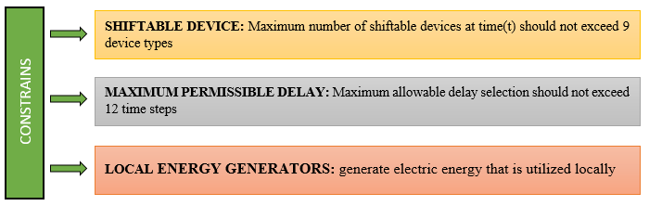
CONSTRAINTS INVOLVED
CONSTRAINTS

Slide 10
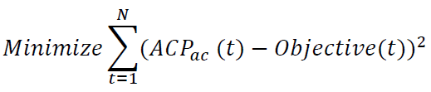
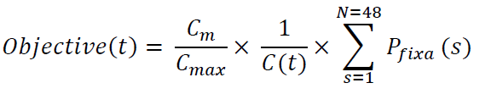
DSM Modelling
Proposed load shifting technique is mathematically formulated as follows.
Where Objective(t) is the value of the objective curve at time t
$ACP_{ac}\left(t\right)$ is the actual consumption at time t.

Slide 11

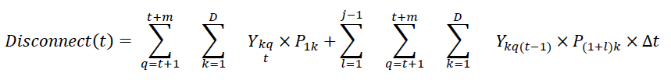
Shifting of Loads
Where Y_{kit} is the number of devices of type that are shifted from time step i to t,D is the number of device types, P_{1k} and P_{(1+l)k} are the power consumptions at time steps 1 and (1+l).
Where Y_{ktq} is the number of devices of type that are delayed from time step t to q , m is the maximum allowable delay.

Slide 12
Connect
Disconnect

Slide 13
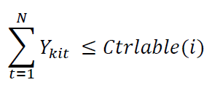
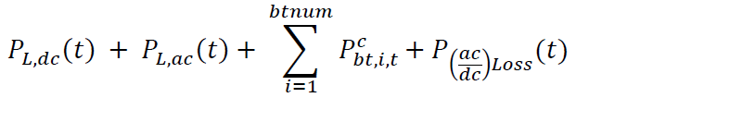
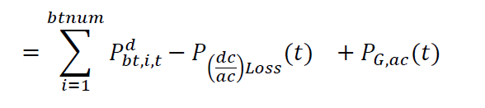
The total number of controllable devices at a particular time step must be less than or equal to the total number of available devices at that time step. A constraint related to this can be formulated as: -
The power balancing equation for entire distribution system is given as :-

Slide 14
Optimization through GA
In the genetic algorithm process is as follows:
Step 1. Determine the number of chromosomes, generation, and mutation rate and crossover rate value
Step 2. Generate chromosome-chromosome number of the population, and the initialization value of the genes chromosome-chromosome with a random value
Step 3. Process steps 4-7 until the number of generations is met
Step 4. Evaluation of fitness value of chromosomes by calculating objective function
Step 5. Chromosomes selection
Step 5. Crossover
Step 6. Mutation
Step 7. New Chromosomes (Offspring)
Step 8. Solution (Best Chromosomes)

Slide 15
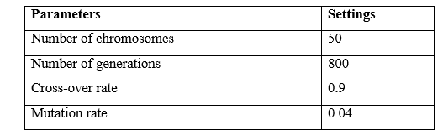
The optimization of the DSM model built is solved using genetic algorithm, and values shown in Table 4.1 are passed on during the program runtime to obtain the optimized solution. These values are arrived from a reference paper [21].

Slide 16
Test System
The system considered for simulation is from Mumbai, the capital city of Maharashtra state in India. The approximate population and spread over area of the city is 12.5 million and 437.5 km², respectively.
As this test system has already been studied and analysed applying DSM strategy whose results are discussed by Nandkishor Kinhekar [17], is considered here for simulation.

Slide 17
Hourly Forecasted Load
Time | Price | Hourly Forecasted Load (kW)
 |  | Residential | Commercial | Industrial
08:00 – 09:00 | 12.00 | 729.4 | 923.5 | 2045.5
09:00 – 10:00 | 9.19 | 713.5 | 1154.4 | 2435.1
10:00 – 11:00 | 12.27 | 713.5 | 1443.0 | 2629.9
11:00 – 12:00 | 20.69 | 808.7 | 1558.4 | 2727.3
12:00 – 13:00 | 26.82 | 824.5 | 1673.9 | 2435.1
14:00 – 15:00 | 13.81 | 745.2 | 1673.9 | 2678.6
15:00 – 16:00 | 17.31 | 681.8 | 1587.3 | 2629.9
16:00 – 17:00 | 16.42 | 667 | 1558.4 | 2532.5
17:00 – 18:00 | 9.83 | 951.4 | 1673.9 | 2094.2
18:00 – 19:00 | 8.63 | 1220.9 | 1818.2 | 1704.5
19:00 – 20:00 | 8.87 | 1331.9 | 1500.7 | 1509.7
Time | Price | Hourly Forecasted Load (kW)
 |  | Residential | Commercial | Industrial
20:00 – 21:00 | 8.35 | 1363.6 | 1298.7 | 1363.6
22:00 – 23:00 | 16.19 | 1046.5 | 923.5 | 1120.1
23:00 – 00:00 | 8.87 | 761.1 | 577.2 | 1022.7
00:00 – 01:00 | 8.65 | 475.7 | 404.0 | 974
01:00 – 02:00 | 8.11 | 412.3 | 375.2 | 876.6
02:00 – 03:00 | 8.25 | 364.7 | 375.2 | 827.9
03:00 – 04:00 | 8.10 | 348.8 | 404.0 | 730.5
04:00 – 05:00 | 8.14 | 269.6 | 432.9 | 730.5
05:00 – 06:00 | 8.13 | 269.6 | 432.9 | 779.2
06:00 – 07:00 | 8.34 | 412.3 | 432.9 | 1120.1
07:00 – 08:00 | 9.35 | 539.1 | 663.8 | 1509.7

Slide 18
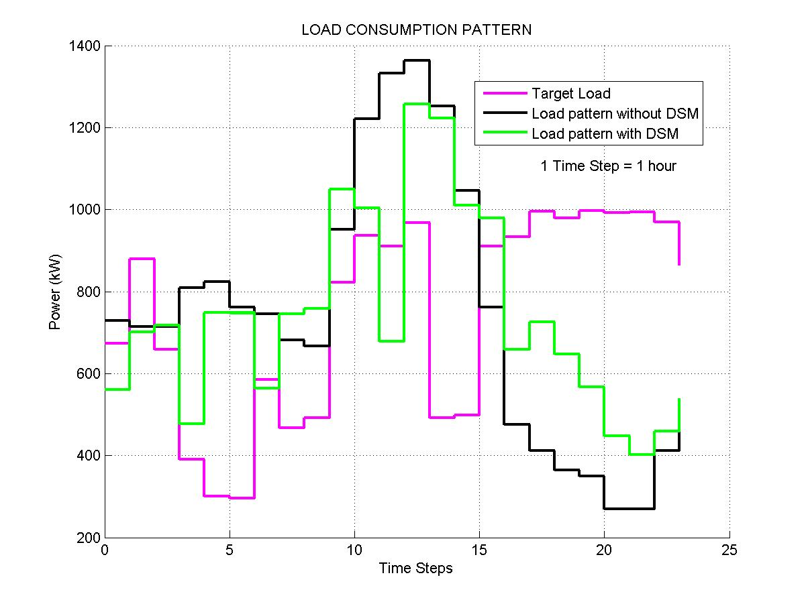
Test System – Residential Area

Slide 19
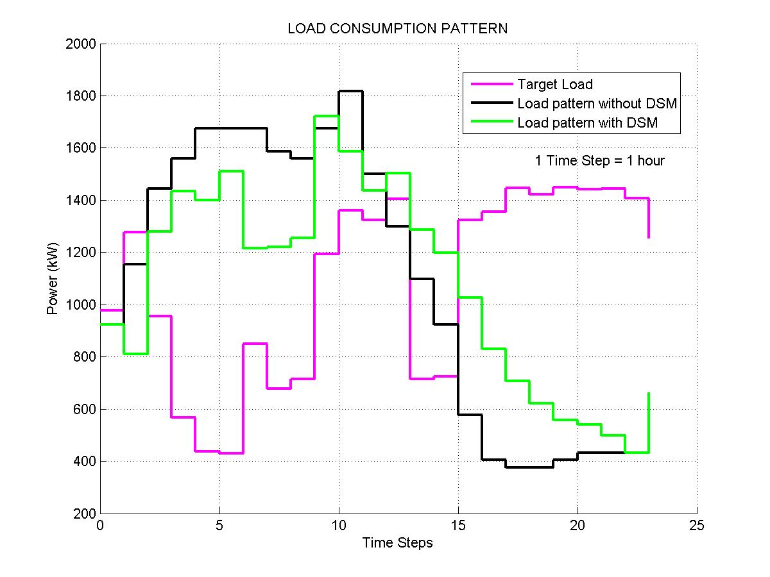
Test System – Commercial Area

Slide 20
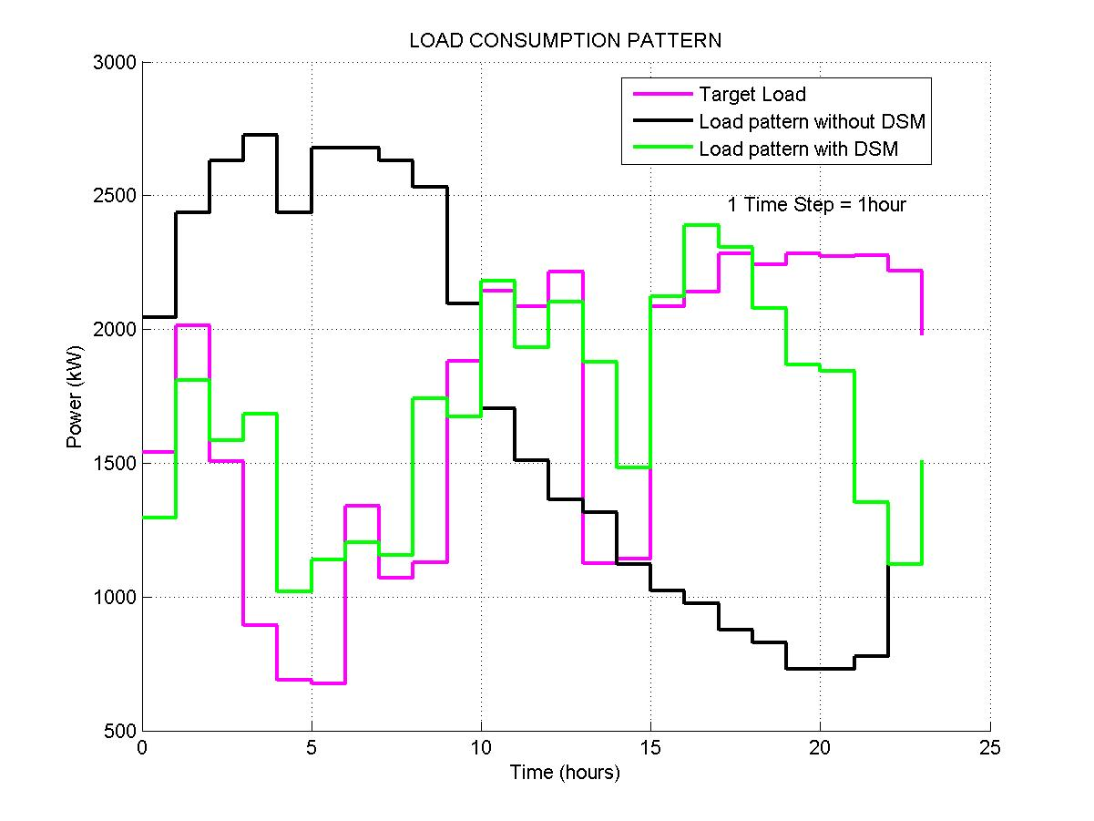
Test System – Industrial Area

Slide 21
CAMPUS LOAD STUDY

Slide 22
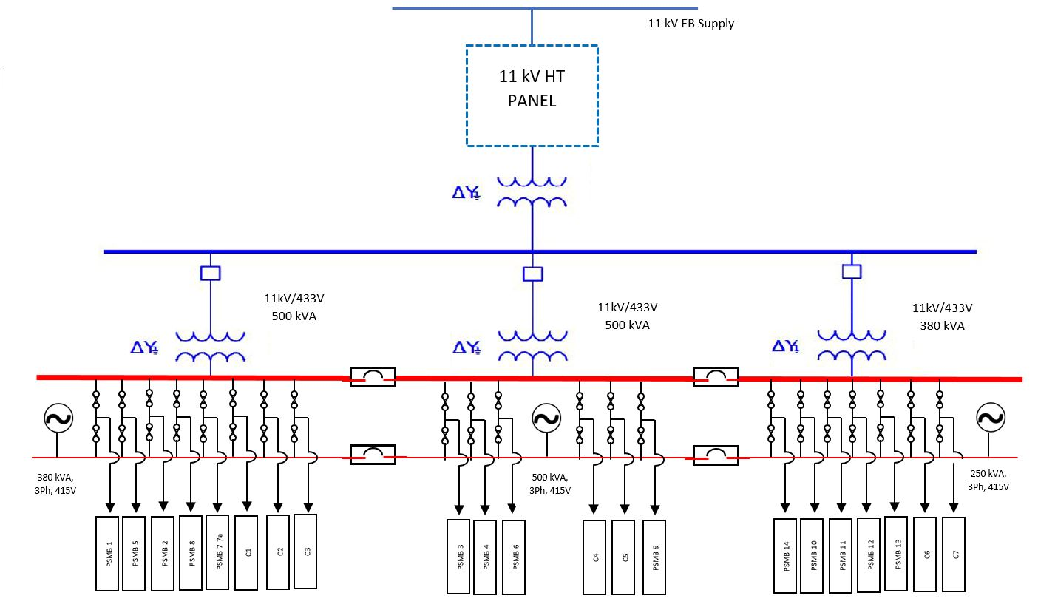
Campus one line diagram

Slide 23
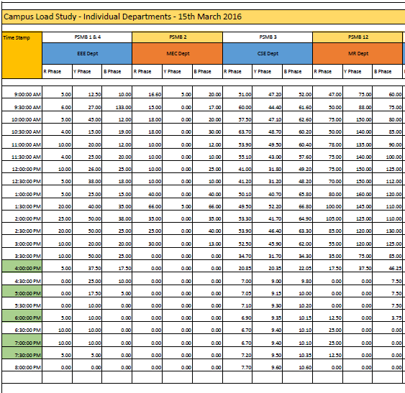
CAMPUS LOAD STUDY Period - ( 24 Hrs )
Mechanical
Electrical
Computer Science
Marine
ECE & Civil
Mechanical Workshop
Air Conditioners – Overall
Canteen
Hostel
Library & Admin Block
Lighting Loads – Classrooms

Slide 24
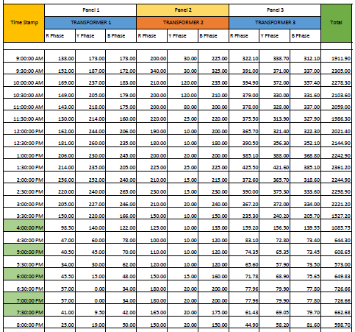
Distribution Transformer Data Period - ( 24 Hrs )

Slide 25

Campus target load fixing
Education institution follows flat tariff for electricity.
Tracking dynamic pricing is difficult in this scenario, Hence, we divide the time period into four phases.
For college campus objective curve is fixed by averaging the load for the given time period and the equation is,
24 hours
Phase I
Phase II
Phase III
Phase IV
8:30 hrs
12:30 hrs
15:30 hrs
21:30 hrs
8:30 hrs

Slide 26
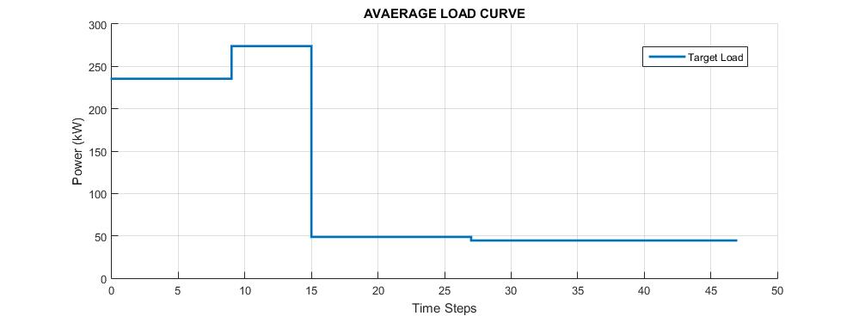
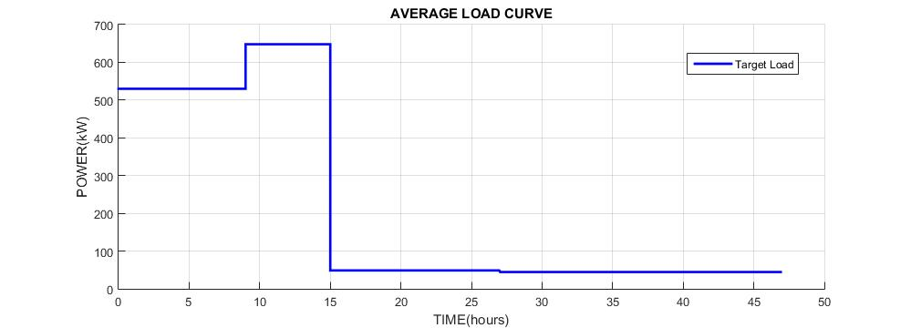
Target load curves
Typical target load
Target Load during Peak demand hours

Slide 27
CAMPUS DEMAND SIDE MANAGEMENT
IMPLEMENTATION
SCENARIO 1 – Primary Supply alone
SCENARIO 2 – DSM during peak demand hours
SCENARIO 3 – Primary Supply with PV Integration
SCENARIO 4 – DSM with PV during Peak demand hour
SCENARIO 5 – Diesel Generator with PV Integration

Slide 28
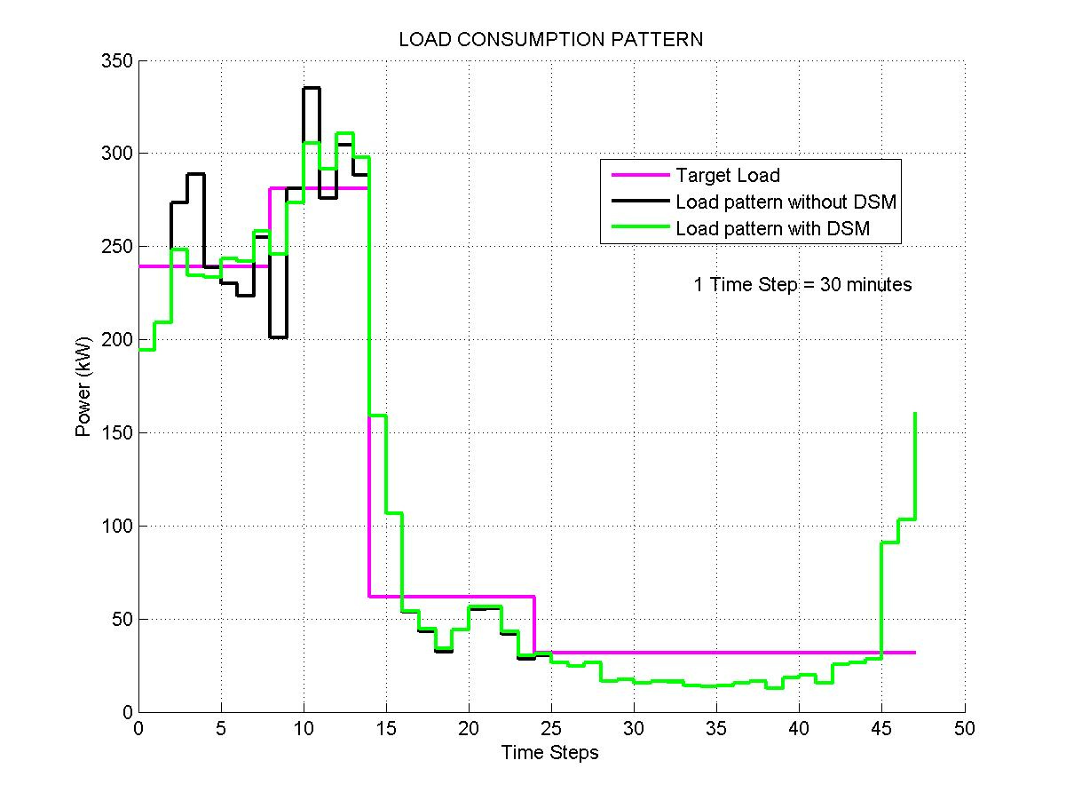
SCENARIO 1: Primary Supply alone
Simulations carried out for a system model powered solely by Primary power supply.
This model excludes the existing solar panel and Diesel Generators.
The results obtained on implementing DSM Strategy is shown in the graph.

Slide 29
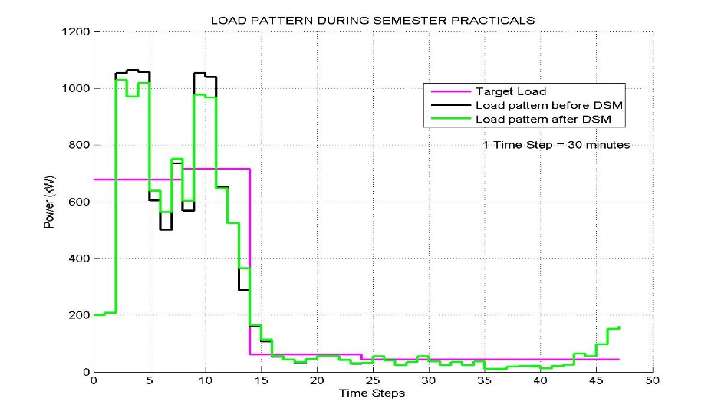
SCENARIO 2: DSM during peak demand hours
The maximum demand exceeds the permitted demand value, during end semester examinations.
On doing so, penalty charges are added to the utility bill, which leads to hike in total consumption charge.

Slide 30
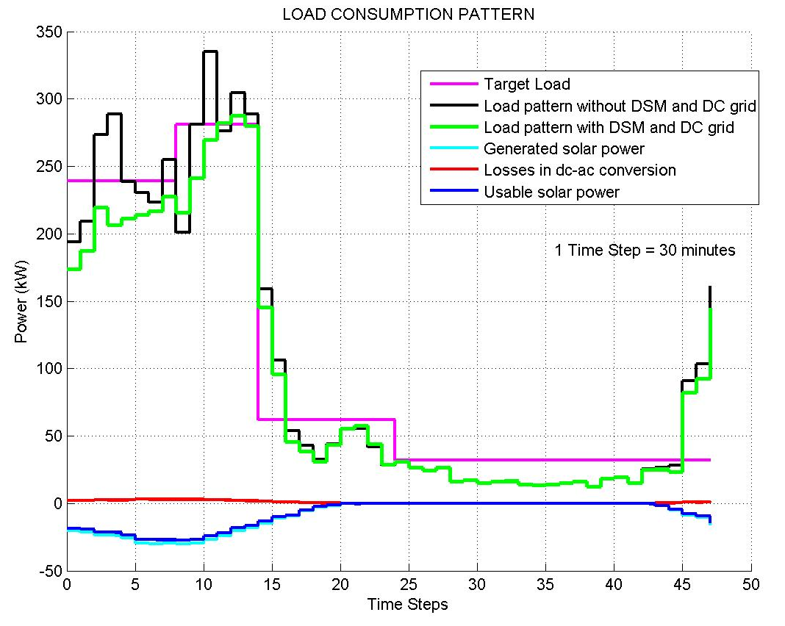
SCENARIO 3: Primary Supply with PV Integration
Simulations carried out for a system model powered by TNEB and existing 35kW PV Array.
This model excludes the usage of existing diesel generators.
The results obtained on implementing DSM Strategy is shown in the graph.

Slide 31
SCENARIO 4: DSM with PV during Peak demand hour
The scenario 3 is extended with solar integration and applied during peak demand hours.
This usually occurs during the end semester examination. The results obtained are shown below

Slide 32
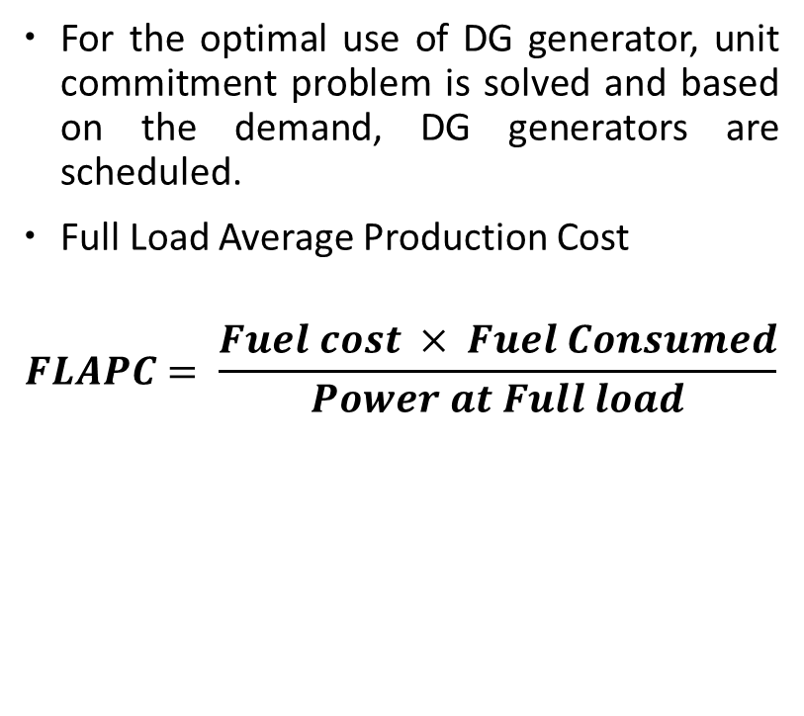
SCENARIO 5: DG with PV Integration
DG | FLAPC (Rs) | Base Charge (Rs) | Incremental cost (Rs)
1 | 13.475 | 808.5 | 9.43
2 | 9.671 | 882 | 6.77
3 | 8.575 | 1029 | 6
For the optimal use of DG generator, unit commitment problem is solved and based on the demand, DG generators are scheduled.
Full Load Average Production Cost
$$FLAPC= \frac{Fuel cost × Fuel Consumed}{Power at Full load}$$

Slide 33
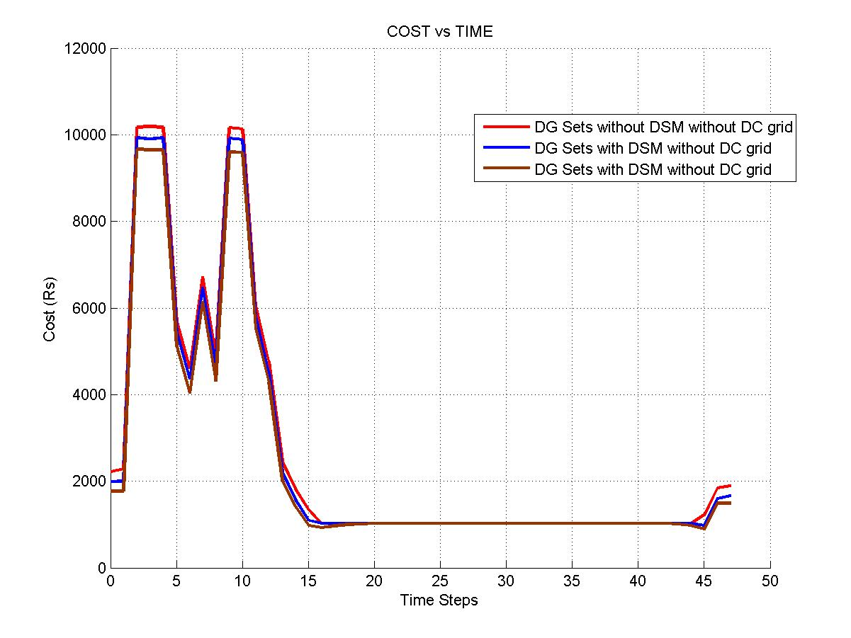
The commitment scheme would simply use only one of the following combinations as shown in table below.
Combi-nation | MIN kW from combination | MAX kW from combination
3+2+1 | 270 | 910
3+2 | 210 | 710
3 | 120 | 400

Slide 34
Results
 | Peak Reduction in % | Cost reduction (Rs) |  | Cost reduction in %
Non - Peak demand hours
Primary supply alone | 4.545 |  | nil | nil
Primary supply with PV Integration | 14.1184 |  | nil | nil
Peak demand hours
Primary supply alone | 3.32 |  | 14,960.00 | 11.39
Primary supply with PV Integration | 6.09 |  | 37,400.00 | 28.48
DG with PV Integration | 5.762 |  | 4,699.00 | 3.65

Slide 35
Conclusion
The proposed strategy is a generalized technique based on load shifting, which has been mathematically formulated as a minimization problem.
A heuristic based evolutionary algorithm is developed for solving the problem.
The simulation outcomes carried out for a campus infrastructure shows that the proposed algorithm is able to handle a large number of controllable devices of several types, and achieves substantial savings while reducing the peak load demand.
Highlights :-
Efficient allocation and usage of available DG Sets, which inturn reduces fuel cost, pollution, lifespan and maintenance.
Best utilization of existing 35kW Photovoltaic panels.
Support for future expansion of renewable assets.

Slide 36
References:
[1] Nandkishor Kinhekar and Narayana Prasad Padhy, “Utility Oriented Demand Side Management Using Smart AC and Micro DC Grid Cooperative”, Year: 2015, Volume: PP, Issue: 99 Pages: 1 – 10.
[2] Thillainathan Logenthiran and Dipti Srinivasan, “Demand Side Management in Smart Grid Using Heuristic Optimization”, Year: 2012, Volume: 3, Issue: 3 Pages: 1244 – 1252.
[1] Q. Li and M. Zhou, “The future-oriented grid-smart grid,” J. Comput.,vol. 6, no. 1, pp. 98–105, 2011.
[2] P. Agrawal, “Overview of DOE microgrid activities,” in Proc. Symp. Microgrid,Montreal,QC, Canada, 2006 [Online].Available: http://der.lbl.gov/2006microgrids_files/USA/Presentation_7_Part1_Poonumgrawal.pdf
[3] S. Rahman and Rinaldy, “An efficient load model for analyzing demand side management impacts,” IEEE Trans. Power Syst., vol. 8, no.3, pp. 1219–1226, Aug. 1993.
[4] A. I. Cohen and C. C. Wang, “An optimization method for load management scheduling,” IEEE Trans. Power Syst., vol. 3, no. 2, pp.612–618, May 1988.
[5] K.-H. Ng and G. B. Sheblé, “Direct load control-A profit-based load management using linear programming,” IEEE Trans. Power Syst., vol. 13, no. 2, pp. 688–694, May 1998.
[6] F. C. Schweppe, B. Daryanian, and R. D. Tabors, “Algorithms for a spot price responding residential load controller,” IEEE Trans. Power Syst., vol. 4, no. 2, pp. 507–516, May 1989.

Slide 37
Thank You !!

